Slide 1
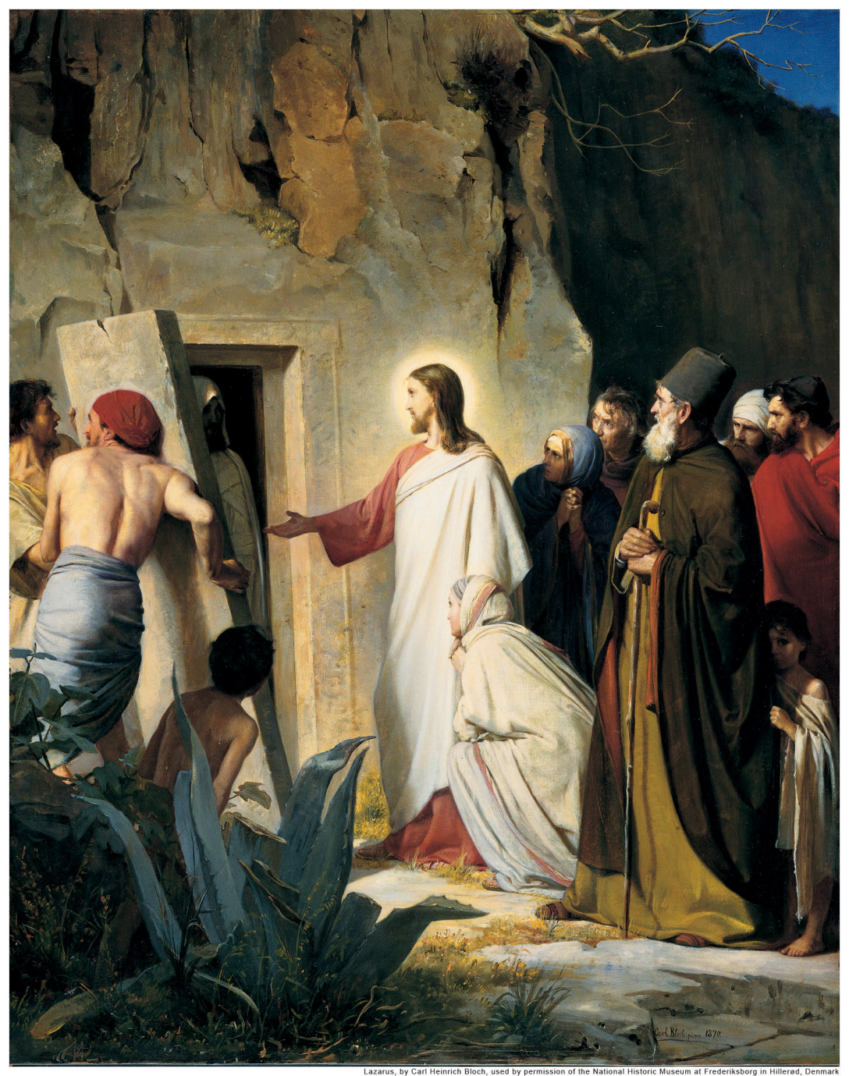
I AM the Resurrection and the Life (John 11)

Slide 2
Leo Tolstoy
My question—that which at the age of fifty brought me to the verge of suicide—was the simplest of questions, lying in the soul of every man . . . a question without an answer to which one cannot live, as I had found by experience. It was: ‘What will come of what I am doing today or shall do tomorrow? What will come of my whole life? . . . Is there any meaning in my life that the inevitable death awaiting me does not destroy?

Slide 3
John 11:1-6
Now a man named Lazarus was sick. He was from Bethany, the village of Mary and her sister Martha. This Mary, whose brother Lazarus now lay sick, was the same one who poured perfume on the Lord and wiped his feet with her hair. So the sisters sent word to Jesus, “Lord, the one you love is sick.”
When he heard this, Jesus said, “This sickness will not end in death. No, it is for God’s glory so that God’s Son may be glorified through it.” Jesus loved Martha and her sister and Lazarus. Yet when he heard that Lazarus was sick, he stayed where he was two more days.

Slide 4
John 11:7-8
Then he said to his disciples, “Let us go back to Judea.”
“But Rabbi,” they said, “a short while ago the Jews tried to stone you, and yet you are going back there?”

Slide 5
John 11:11-16
After he had said this, he went on to tell them, “Our friend Lazarus has fallen asleep; but I am going there to wake him up.”
His disciples replied, “Lord, if he sleeps, he will get better.” Jesus had been speaking of his death, but his disciples thought he meant natural sleep.
So then he told them plainly, “Lazarus is dead, and for your sake I am glad I was not there, so that you may believe. But let us go to him.”
Then Thomas (called Didymus) said to the rest of the disciples, “Let us also go, that we may die with him.”

Slide 6
John 11:21-26
“Lord,” Martha said to Jesus, “if you had been here, my brother would not have died. But I know that even now God will give you whatever you ask.”
Jesus said to her, “Your brother will rise again.”
Martha answered, “I know he will rise again in the resurrection at the last day.”
Jesus said to her, “I am the resurrection and the life. He who believes in me will live, even though he dies; and whoever lives and believes in me will never die. Do you believe this?”

Slide 7
John 11:32-36
When Mary reached the place where Jesus was and saw him, she fell at his feet and said, “Lord, if you had been here, my brother would not have died.”
When Jesus saw her weeping, and the Jews who had come along with her also weeping, he was deeply moved in spirit and troubled. “Where have you laid him?” he asked.
“Come and see, Lord,” they replied.
Jesus wept.
Then the Jews said, “See how he loved him!”

Slide 8
John 11:38-44
Jesus, once more deeply moved, came to the tomb. It was a cave with a stone laid across the entrance. “Take away the stone,” he said.
“But, Lord,” said Martha, the sister of the dead man, “by this time there is a bad odor, for he has been there four days.”
Then Jesus said, “Did I not tell you that if you believed, you would see the glory of God?”
So they took away the stone. Then Jesus looked up and said, “Father, I thank you that you have heard me. I knew that you always hear me, but I said this for the benefit of the people standing here, that they may believe that you sent me.”
When he had said this, Jesus called in a loud voice, “Lazarus, come out!” The dead man came out, his hands and feet wrapped with strips of linen, and a cloth around his face.
Jesus said to them, “Take off the grave clothes and let him go.”

Slide 9
1st Thess. 4:13-15
Brothers, we do not want you to be ignorant about those who fall asleep, or to grieve like the rest of men, who have no hope. We believe that Jesus died and rose again and so we believe that God will bring with Jesus those who have fallen asleep in him.

