Slide 1
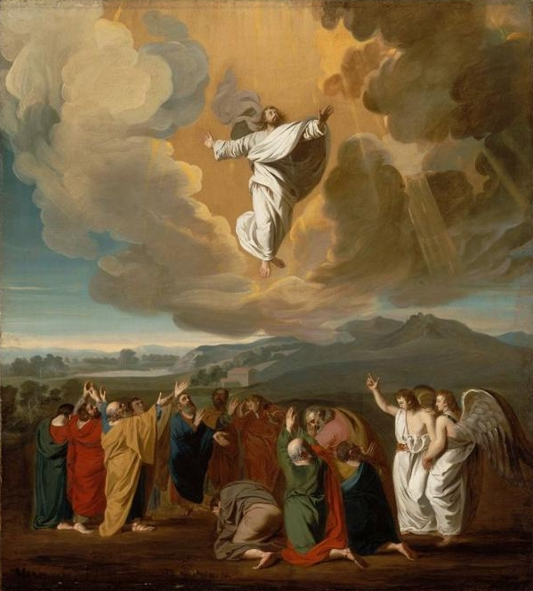
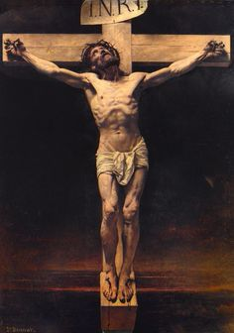
Who is this “Son of man”? (John 12:20-43)

Slide 2
John 12:20-26
Now there were some Greeks among those who went up to worship at the Feast. They came to Philip, who was from Bethsaida in Galilee, with a request. “Sir,” they said, “we would like to see Jesus.” Philip went to tell Andrew; Andrew and Philip in turn told Jesus.
Jesus replied, “The hour has come for the Son of Man to be glorified. I tell you the truth, unless a kernel of wheat falls to the ground and dies, it remains only a single seed. But if it dies, it produces many seeds. The man who loves his life will lose it, while the man who hates his life in this world will keep it for eternal life. Whoever serves me must follow me; and where I am, my servant also will be. My Father will honor the one who serves me.

Slide 3
Daniel 7:13-14
“In my vision at night I looked, and there before me was one like a son of man, coming with the clouds of heaven. He approached the Ancient of Days and was led into his presence. He was given authority, glory and sovereign power; all peoples, nations and men of every language worshiped him. His dominion is an everlasting dominion that will not pass away, and his kingdom is one that will never be destroyed.

Slide 4
Matthew 26:63-64
The high priest said to him, “I charge you under oath by the living God: Tell us if you are the Christ, the Son of God.”
“Yes, it is as you say,” Jesus replied. “But I say to all of you: In the future you will see the Son of Man sitting at the right hand of the Mighty One and coming on the clouds of heaven.”

Slide 5
John 12:27-33
“Now my heart is troubled, and what shall I say? ‘Father, save me from this hour’? No, it was for this very reason I came to this hour. Father, glorify your name!”
Then a voice came from heaven, “I have glorified it, and will glorify it again.” The crowd that was there and heard it said it had thundered; others said an angel had spoken to him.
Jesus said, “This voice was for your benefit, not mine. Now is the time for judgment on this world; now the prince of this world will be driven out. But I, when I am lifted up from the earth, will draw all men to myself.” He said this to show the kind of death he was going to die.

Slide 6
John 12:34-36
The crowd spoke up, “We have heard from the Law that the Christ will remain forever, so how can you say, ‘The Son of Man must be lifted up’? Who is this ‘Son of Man’?”
Then Jesus told them, “You are going to have the light just a little while longer. Walk while you have the light, before darkness overtakes you. The man who walks in the dark does not know where he is going. Put your trust in the light while you have it, so that you may become sons of light.” When he had finished speaking, Jesus left and hid himself from them.

Slide 7
John 12:37-43
Even after Jesus had done all these miraculous signs in their presence, they still would not believe in him. This was to fulfill the word of Isaiah the prophet: “Lord, who has believed our message and to whom has the arm of the Lord been revealed?” For this reason they could not believe, because, as Isaiah says elsewhere: “He has blinded their eyes and deadened their hearts, so they can neither see with their eyes, nor understand with their hearts, nor turn—and I would heal them.” Isaiah said this because he saw Jesus’ glory and spoke about him.
Yet at the same time many even among the leaders believed in him. But because of the Pharisees they would not confess their faith for fear they would be put out of the synagogue; for they loved praise from men more than praise from God.

Slide 8
Isaiah 53:1-6
Who has believed our message and to whom has the arm of the LORD been revealed?
He grew up before him like a tender shoot, and like a root out of dry ground. He had no beauty or majesty to attract us to him, nothing in his appearance that we should desire him.
He was despised and rejected by men, a man of sorrows, and familiar with suffering.
Like one from whom men hide their faces he was despised, and we esteemed him not.
Surely he took up our infirmities and carried our sorrows, yet we considered him stricken by God, smitten by him, and afflicted. But he was pierced for our transgressions, he was crushed for our iniquities; the punishment that brought us peace was upon him, and by his wounds we are healed.
We all, like sheep, have gone astray, each of us has turned to his own way; and the LORD has laid on him the iniquity of us all.

Slide 9
John 20:30-31
Jesus did many other miraculous signs in the presence of his disciples, which are not recorded in this book. But these are written that you may believe that Jesus is the Christ, the Son of God, and that by believing you may have life in his name.

