Slide 1
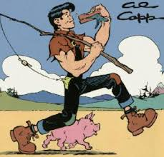

Slide 2
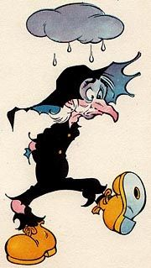

Slide 3
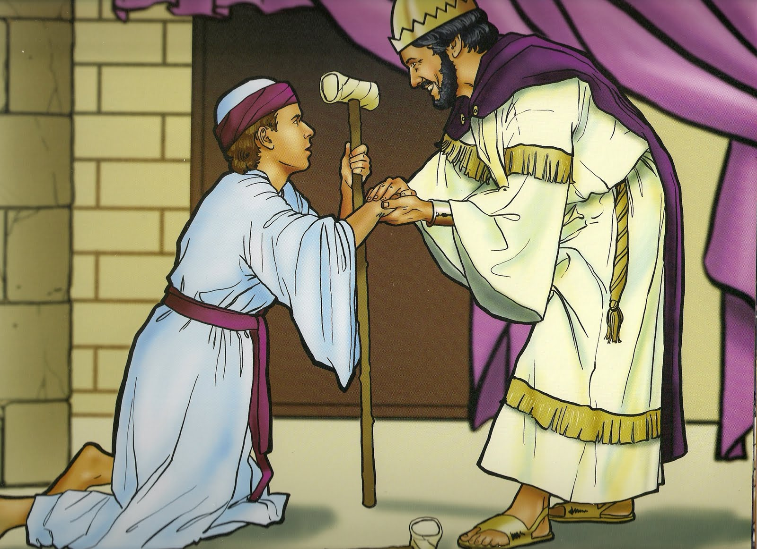
2nd Samuel (The story of Mephibosheth)

Slide 4
2nd Samuel 4:4
Jonathan son of Saul had a son who was lame in both feet. He was five years old when the news about Saul and Jonathan came from Jezreel. His nurse picked him up and fled, but as she hurried to leave, he fell and became crippled. His name was Mephibosheth.

Slide 5
2nd Samuel 9:1-5
David asked, “Is there anyone still left of the house of Saul to whom I can show kindness for Jonathan’s sake?”
Now there was a servant of Saul’s household named Ziba. They called him to appear before David, and the king said to him, “Are you Ziba?”
“Your servant,” he replied.
The king asked, “Is there no one still left of the house of Saul to whom I can show God’s kindness?”
Ziba answered the king, “There is still a son of Jonathan; he is crippled in both feet.”
“Where is he?” the king asked.
Ziba answered, “He is at the house of Makir son of Ammiel in Lo Debar.”
So King David had him brought from Lo Debar, from the house of Makir son of Ammiel.

Slide 6
2nd Samuel 9:6-8
When Mephibosheth son of Jonathan, the son of Saul, came to David, he bowed down to pay him honor.
David said, “Mephibosheth!”
“Your servant,” he replied.
“Don’t be afraid,” David said to him, “for I will surely show you kindness for the sake of your father Jonathan. I will restore to you all the land that belonged to your grandfather Saul, and you will always eat at my table.”
Mephibosheth bowed down and said, “What is your servant, that you should notice a dead dog like me?”

Slide 7
2nd Samuel 9:9-13
Then the king summoned Ziba, Saul’s servant, and said to him, “I have given your master’s grandson everything that belonged to Saul and his family. You and your sons and your servants are to farm the land for him and bring in the crops, so that your master’s grandson may be provided for. And Mephibosheth, grandson of your master, will always eat at my table.” (Now Ziba had fifteen sons and twenty servants.)
Then Ziba said to the king, “Your servant will do whatever my lord the king commands his servant to do.” So Mephibosheth ate at David’s table like one of the king’s sons.
Mephibosheth had a young son named Mica, and all the members of Ziba’s household were servants of Mephibosheth. And Mephibosheth lived in Jerusalem, because he always ate at the king’s table, and he was crippled in both feet.

