Slide 1
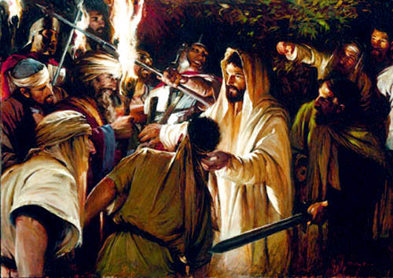
John 18:1-14 (Jesus is betrayed in the Garden)

Slide 2
John 18:1-9
When he had finished praying, Jesus left with his disciples and crossed the Kidron Valley. On the other side there was an olive grove, and he and his disciples went into it.
Now Judas, who betrayed him, knew the place, because Jesus had often met there with his disciples. So Judas came to the grove, guiding a detachment of soldiers and some officials from the chief priests and Pharisees. They were carrying torches, lanterns and weapons.
Jesus, knowing all that was going to happen to him, went out and asked them, “Who is it you want?”
“Jesus of Nazareth,” they replied.
“I AM (he),” Jesus said. (And Judas the traitor was standing there with them.) When Jesus said, “I AM (he),” they drew back and fell to the ground.
Again he asked them, “Who is it you want?”
And they said, “Jesus of Nazareth.”
“I told you that I AM (he)” Jesus answered. “If you are looking for me, then let these men go.” This happened so that the words he had spoken would be fulfilled: “I have not lost one of those you gave me.”

Slide 3
Exodus 3: 13-15
Moses said to God, “Suppose I go to the Israelites and say to them, ‘The God of your fathers has sent me to you,’ and they ask me, ‘What is his name?’ Then what shall I tell them?”
God said to Moses, “I AM WHO I AM. This is what you are to say to the Israelites: ‘I AM has sent me to you.’ ”
God also said to Moses, “Say to the Israelites, ‘The Lord, the God of your fathers—the God of Abraham, the God of Isaac and the God of Jacob—has sent me to you.’ This is my name forever, the name by which I am to be remembered from generation to generation.

Slide 4
Seven images Jesus uses to express his divine nature
I am the Bread of Life
I am the Light of the World
I am the Gate for the sheep
I am the Good Shepherd
I am the Resurrection and the Life
I am the Way, the Truth, and the Life
I am the True Vine.

Slide 5
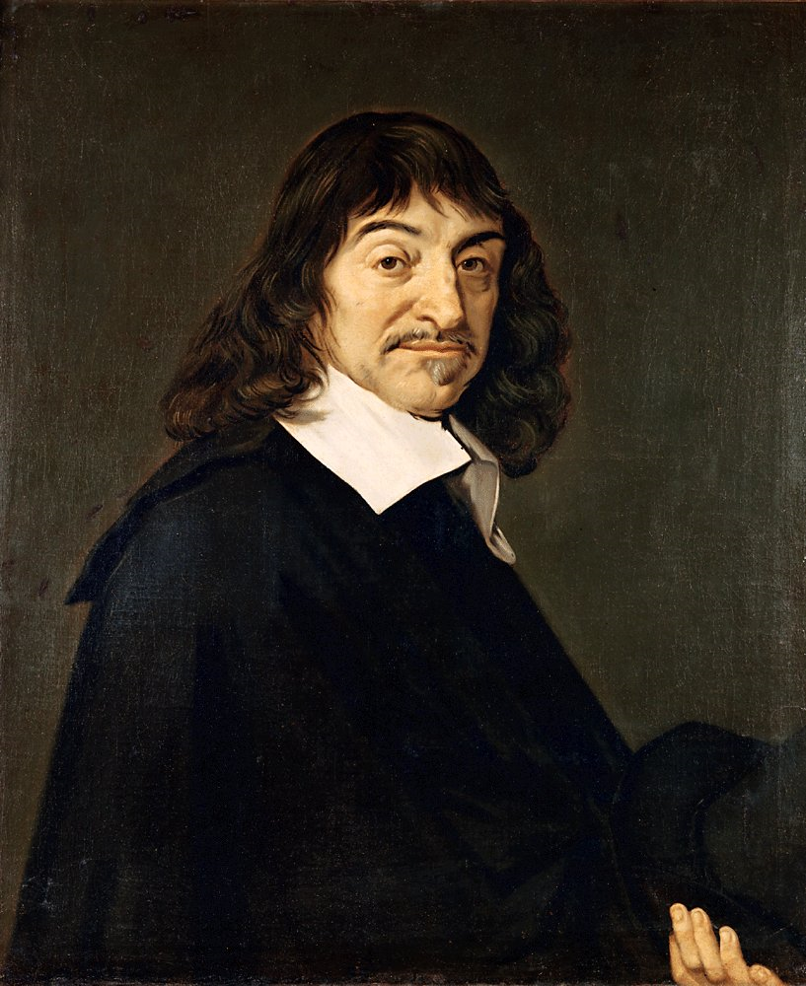
“I doubt therefore I Think, I Think therefore I AM”
Rene Descartes

Slide 6
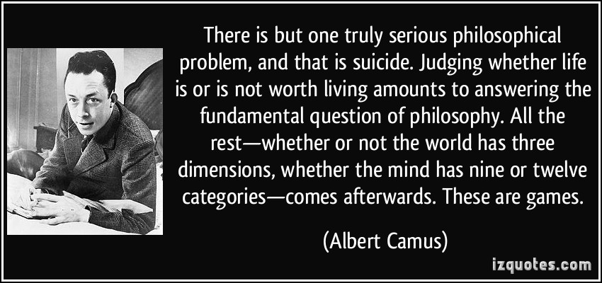

Slide 7
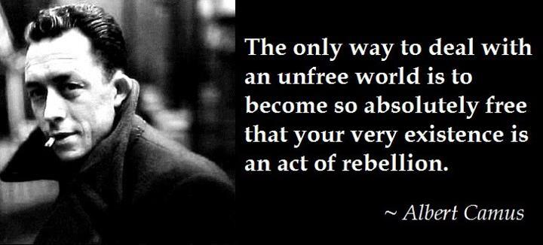

Slide 8
Existentialist Quotes
“That God does not exist, I cannot deny, That my whole being cries out for God I cannot forget.”
“I am no longer sure of anything. If I satiate my desires, I sin but I deliver myself from them; if I refuse to satisfy them, they infect the whole soul.”
Jean-Paul Sartre
"You shall not steal! You shall not kill! Such words were once called holy; before them people bowed their knees and heads, and removed their shoes. But I ask you: where have there ever been better thieves and killers in the world than such holy words have been? Is there not in all of life itself - robbing and killing? And when such words were called holy, was not truth itself thereby - killed?
Friedrich Nietzsche

Slide 10
John 18:10-14
Then Simon Peter, who had a sword, drew it and struck the high priest’s servant, cutting off his right ear. (The servant’s name was Malchus.)
Jesus commanded Peter, “Put your sword away! Shall I not drink the cup the Father has given me?”
Then the detachment of soldiers with its commander and the Jewish officials arrested Jesus. They bound him and brought him first to Annas, who was the father-in-law of Caiaphas, the high priest that year. Caiaphas was the one who had advised the Jews that it would be good if one man died for the people.

