Slide 1
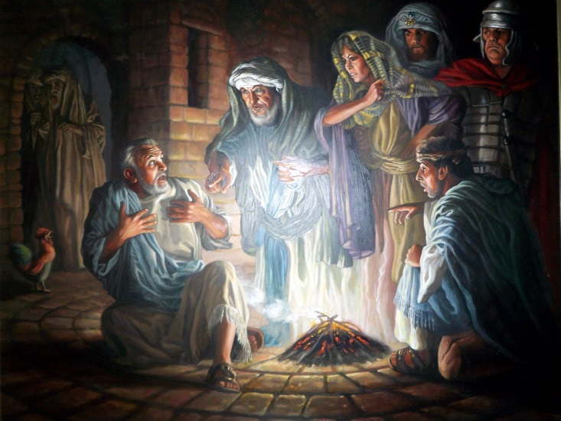
John 18:15-27 (Peter Denies Jesus)

Slide 2
John 13:36-38
Simon Peter asked him, “Lord, where are you going?”
Jesus replied, “Where I am going, you cannot follow now, but you will follow later.”
Peter asked, “Lord, why can’t I follow you now? I will lay down my life for you.”
Then Jesus answered, “Will you really lay down your life for me? I tell you the truth, before the rooster crows, you will disown me three times!

Slide 3
John 18:15-18
Simon Peter and another disciple were following Jesus. Because this disciple was known to the high priest, he went with Jesus into the high priest’s courtyard, but Peter had to wait outside at the door. The other disciple, who was known to the high priest, came back, spoke to the girl on duty there and brought Peter in.
“You are not one of his disciples, are you?” the girl at the door asked Peter.
He replied, “I am not.”
It was cold, and the servants and officials stood around a fire they had made to keep warm. Peter also was standing with them, warming himself.

Slide 4
John 18:19-24
Meanwhile, the high priest questioned Jesus about his disciples and his teaching.
“I have spoken openly to the world,” Jesus replied. “I always taught in synagogues or at the temple, where all the Jews come together. I said nothing in secret. Why question me? Ask those who heard me. Surely they know what I said.”
When Jesus said this, one of the officials nearby struck him in the face. “Is this the way you answer the high priest?” he demanded.
“If I said something wrong,” Jesus replied, “testify as to what is wrong. But if I spoke the truth, why did you strike me?” Then Annas sent him, still bound, to Caiaphas the high priest.

Slide 5
John 18:25-27
As Simon Peter stood warming himself, he was asked, “You are not one of his disciples, are you?”
He denied it, saying, “I am not.”
One of the high priest’s servants, a relative of the man whose ear Peter had cut off, challenged him, “Didn’t I see you with him in the olive grove?” Again Peter denied it, and at that moment a rooster began to crow.

Slide 6
John 21:15-17
When they had finished eating, Jesus said to Simon Peter, “Simon son of John, do you truly love me more than these?”
“Yes, Lord,” he said, “you know that I love you.” Jesus said, “Feed my lambs.”
Again Jesus said, “Simon son of John, do you truly love me?”
He answered, “Yes, Lord, you know that I love you.” Jesus said, “Take care of my sheep.”
The third time he said to him, “Simon son of John, do you love me?”
Peter was hurt because Jesus asked him the third time, “Do you love me?” He said, “Lord, you know all things; you know that I love you.” Jesus said, “Feed my sheep.”

Slide 7
John 21:18-19
I tell you the truth, when you were younger you dressed yourself and went where you wanted; but when you are old you will stretch out your hands, and someone else will dress you and lead you where you do not want to go.” Jesus said this to indicate the kind of death by which Peter would glorify God. Then he said to him, “Follow me!”

