Slide 1
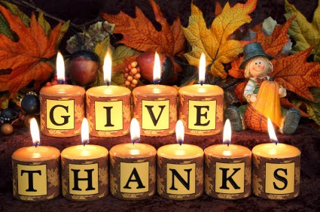
Give thanks in All Things 1st Thess. 5:18

Slide 2
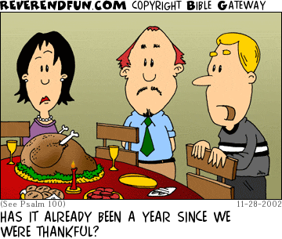

Slide 3
1st Tim. 4:4-5
For everything God created is good, and nothing is to be rejected if it is received with thanksgiving, because it is consecrated by the word of God and prayer.

Slide 4
Apostolic Constitutions
“Blessed art thou, O Lord, who feedest me from my youth, who givest food to all flesh: Fill our hearts with joy and gladness, that we, having all sufficiency, may abound unto every good work in Christ Jesus our Lord, through whom glory, honour, and might, be to thee for ever. Amen.”

Slide 5
Mark 8:6-9
He told the crowd to sit down on the ground. When he had taken the seven loaves and given thanks, he broke them and gave them to his disciples to set before the people, and they did so. They had a few small fish as well; he gave thanks for them also and told the disciples to distribute them. The people ate and were satisfied. Afterward the disciples picked up seven basketfuls of broken pieces that were left over. About four thousand men were present.

Slide 6
Luke 24:30-31
When he was at the table with them, he took bread, gave thanks, broke it and began to give it to them. Then their eyes were opened and they recognized him, and he disappeared from their sight.

Slide 7
Luke 22:19
And he took bread, gave thanks and broke it, and gave it to them, saying, “This is my body given for you; do this in remembrance of me.”

Slide 8
1st Thess. 5: 16-18
Be joyful always; pray continually; give thanks in all circumstances, for this is God’s will for you in Christ Jesus.

Slide 9
Daniel 6:10
Now when Daniel learned that the decree had been published, he went home to his upstairs room where the windows opened toward Jerusalem. Three times a day he got down on his knees and prayed, giving thanks to his God, just as he had done before. Then these men went as a group and found Daniel praying and asking God for help.

Slide 10
Ephesians 5:19-20
Speak to one another with psalms, hymns and spiritual songs. Sing and make music in your heart to the Lord, always giving thanks to God the Father for everything, in the name of our Lord Jesus Christ.

Slide 11
Col.3:15-17
Let the peace of Christ rule in your hearts, since as members of one body you were called to peace. And be thankful. Let the word of Christ dwell in you richly as you teach and admonish one another with all wisdom, and as you sing psalms, hymns and spiritual songs with gratitude in your hearts to God. And whatever you do, whether in word or deed, do it all in the name of the Lord Jesus, giving thanks to God the Father through him.

