Slide 1
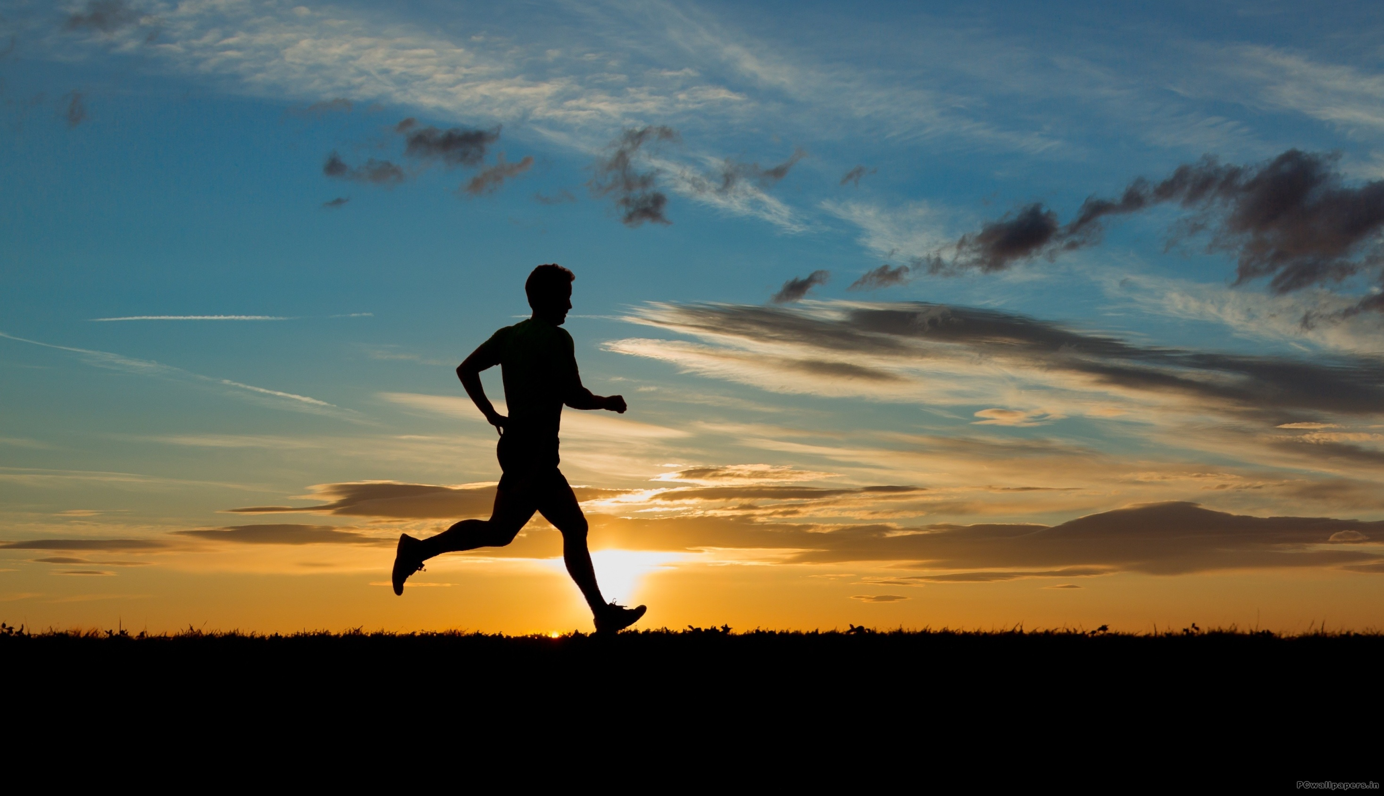
…RUN TO WIN!

Slide 2
Hebrews 12:1b-2 (NLT)
…Let us strip off every weight that slows us down, especially the sin that so easily trips us up. And let us run with endurance the race God has set before us. ² We do this by keeping our eyes on Jesus, the champion who initiates and perfects our faith.

Slide 3
2 Corinthians 9:24-27(NLT)
²⁴ Don’t you realize that in a race everyone runs, but only one person gets the prize? So run to win! ²⁵ All athletes are disciplined in their training. They do it to win a prize that will fade away, but we do it for an eternal prize. ²⁶ So I run with purpose in every step. I am not just shadowboxing. ²⁷ I discipline my body like an athlete, training it to do what it should.

Slide 4
Hebrews 12:1b (NLT)
…Let us strip off every weight that slows us down, especially the sin that so easily trips us up. And let us run with endurance the race God has set before us

Slide 5
Hindrances to “Running Light”
1. Unhealthy Relationships
2.
3.

Slide 6
Proverbs 13:20
He who walks with wise men will be wise, But the companion of fools will suffer harm.

Slide 7
Proverbs 13:20
He who walks with wise men will be wise, But the companion of fools will suffer harm.
1st Corinthians 15:33
Do not be deceived. “Bad company corrupts good morals”.

Slide 8
Proverbs 13:20
He who walks with wise men will be wise, But the companion of fools will suffer harm.
1st Corinthians 15:33
Do not be deceived. “Bad company corrupts good morals”.
1st Thessalonians 5:11a
Therefore encourage one another and build up one another…

Slide 9
Hindrances to “Running Light”
1. Unhealthy Relationships
2. Materialism
3.

Slide 10
ma·te·ri·al·ism
məˈtirēəˌlizəm/
noun
noun: materialism
1.
a tendency to consider material possessions and physical comfort as more important than spiritual values.

Slide 11
Matthew 6:24 (NLT)
“No one can serve two masters. For you will hate one and love the other; you will be devoted to one and despise the other. You cannot serve God and be enslaved to money.

Slide 12
2 Corinthians 4:18 (NIV)
So we fix our eyes not on what is seen, but on what is unseen, since what is seen is temporary, but what is unseen is eternal.

Slide 13
Hindrances to “Running Light”
1. Unhealthy Relationships
2. Materialism
3. Bad Habits and Addictions

Slide 14
Ephesians 4:22-24 (NLT)
²² throw off your old sinful nature and your former way of life, which is corrupted by lust and deception. ²³ Instead, let the Spirit renew your thoughts and attitudes. ²⁴ Put on your new nature, created to be like God—truly righteous and holy.

Slide 15
1 John 2:15-17 (NLT)
¹⁵ Do not love this world nor the things it offers you, for when you love the world, you do not have the love of the Father in you. ¹⁶ For the world offers only a craving for physical pleasure, a craving for everything we see, and pride in our achievements and possessions. These are not from the Father, but are from this world. ¹⁷ And this world is fading away, along with everything that people crave. But anyone who does what pleases God will live forever.

Slide 16
How We “Run To Win!”
1. Run Light
2.
3.
4.

Slide 17
How We “Run To Win!”
1. Run Light
2. Find Your Stride
3.
4.

Slide 18
Psalm 139:13-14 (NLT)
¹³ You made all the delicate, inner parts of my body and knit me together in my mother’s womb. ¹⁴ Thank you for making me so wonderfully complex! Your workmanship is marvelous—how well I know it.

Slide 19
Psalm 139:13-14 (NLT)
¹³ You made all the delicate, inner parts of my body and knit me together in my mother’s womb. ¹⁴ Thank you for making me so wonderfully complex! Your workmanship is marvelous—how well I know it.
Isaiah 64:8 (NLT)
⁸ And yet, O Lord, you are our Father. We are the clay, and you are the potter. We all are formed by your hand.

Slide 20
How We “Run To Win!”
1. Run Light
2. Find Your Stride
3.
4.

Slide 21
How We “Run To Win!”
1. Run Light
2. Find Your Stride
3. Pace Yourself
4.

Slide 22
Mark 6:31 (NLT)
³¹ Then Jesus said, “Let’s go off by ourselves to a quiet place and rest awhile.” He said this because there were so many people coming and going that Jesus and his apostles didn’t even have time to eat.

Slide 23
Isaiah 40:31 (NLT)
³¹ But those who trust in the Lord will find new strength. They will soar high on wings like eagles.
They will run and not grow weary. They will walk and not faint.

Slide 24
How We “Run To Win!”
1. Run Light
2. Find Your Stride
3. Pace Yourself
4.

Slide 25
How We “Run To Win!”
1. Run Light
2. Find Your Stride
3. Pace Yourself
4. Fix Your Eyes on the Goal

Slide 26
Hebrews 12:1b-2 (NLT)
... And let us run with endurance the race God has set before us. ² We do this by keeping our eyes on Jesus, the champion who initiates and perfects our faith.

Slide 27
John 12:32 (NLT)
³² "And when I am lifted up from the earth, I will draw everyone to myself."

Slide 28
Matthew 14:26-28 (NIV)
²⁶ When the disciples saw him walking on the lake, they were terrified. “It’s a ghost,” they said, and cried out in fear.
²⁷ But Jesus immediately said to them: “Take courage! It is I. Don’t be afraid.”
²⁸ “Lord, if it’s you,” Peter replied, “tell me to come to you on the water.”
²⁹ “Come,” he said.
Then Peter got down out of the boat, walked on the water and came toward Jesus.

Slide 29
Hebrews 12:2 (NLT)
² We do this by keeping our eyes on Jesus, the champion who initiates and perfects our faith. Because of the joy awaiting him, he endured the cross, disregarding its shame. Now he is seated in the place of honor beside God’s throne.

Slide 30
2 Timothy 4:7 (NLT)
I have fought the good fight, I have finished the race, I have kept the faith.

