Slide 1

The Jesus Intervention

Slide 2


Slide 3
INFORMATION and INSPIRATION
are often not enough to make a change

Slide 4
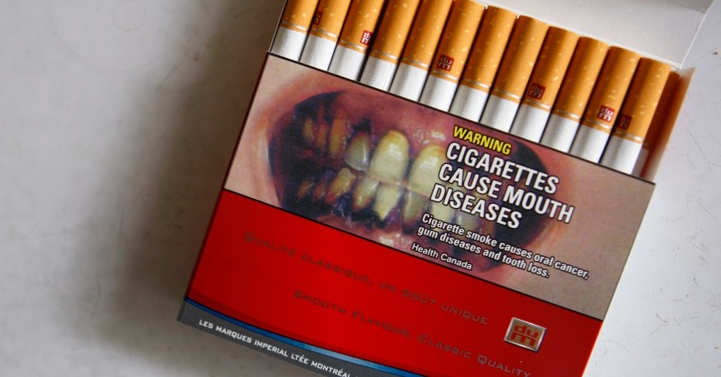

Slide 5
INFORMATION and INSPIRATION
are often not enough to make a change

Slide 6
INFORMATION and INSPIRATION
are often not enough to make a change
Sometimes we need an
INTERVENTION

Slide 7
John 1:1-5
¹ In the beginning the Word already existed.
The Word was with God,
and the Word was God.
² He existed in the beginning with God.
³ God created everything through him,
and nothing was created except through him.
⁴ The Word gave life to everything that was created,
and his life brought light to everyone.
⁵ The light shines in the darkness,
and the darkness can never extinguish it.

Slide 8
Ezekiel 37:1-2,5-10
The Lord took hold of me, and I was carried away by the Spirit of the Lord to a valley filled with bones. ² He led me all around among the bones that covered the valley floor. They were scattered everywhere across the ground and were completely dried out. ⁵ This is what the Sovereign Lord says: Look! I am going to put breath into you and make you live again!
⁶ I will put flesh and muscles on you and cover you with skin. I will put breath into you, and you will come to life. Then you will know that I am the Lord.’”

Slide 9
⁷ So I spoke this message, just as he told me. Suddenly as I spoke, there was a rattling noise all across the valley. The bones of each body came together and attached themselves as complete skeletons. ⁸ Then as I watched, muscles and flesh formed over the bones. Then skin formed to cover their bodies, but they still had no breath in them.
⁹ Then he said to me, “Speak a prophetic message to the winds, son of man. Speak a prophetic message and say, ‘This is what the Sovereign Lord says: Come, O breath, from the four winds! Breathe into these dead bodies so they may live again.’”
¹⁰ So I spoke the message as he commanded me, and breath came into their bodies. They all came to life and stood up on their feet—a great army.

Slide 10
Jesus INTERVENTION gave you life

