Slide 1
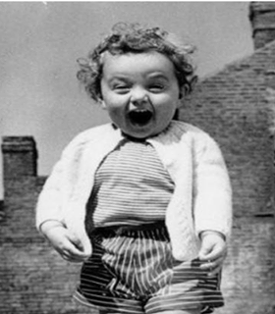
BEST DAY EVER

Slide 2
I Kings 19:18
“Yet I reserve seven thousand in Israel—all whose knees have not bowed down to Baal and all whose mouths have not kissed him.”
.

Slide 3
Galationians 3:29
^{29 And if you are Christ’s,}
^{then you are Abraham’s seed,}
^{and heirs}
^{according to the promise.}

Slide 4
John 12:44-46
⁴⁴ Then Jesus cried out, “When a man believes in me, he does not believe in me only, but in the one who sent me. ⁴⁵ When he looks at me, he sees the one who sent me. ⁴⁶ I have come into the world as a light, so that no one who believes in me should stay in darkness.

Slide 5
John 12:47-48
⁴⁷ “As for the person who hears my words but does not keep them,
I do not judge him. For I did not come to judge the world, but to save it. ⁴⁸ There is a judge for the one who rejects me and does not accept my words; that very word which I spoke will condemn him at the last day.

Slide 6
John 12:49-50
⁴⁹ For I did not speak of my own accord, but the Father who sent me commanded me what to say and how to say it. ⁵⁰ I know that his command leads to eternal life. So whatever I say is just what the Father has told me to say.”

Slide 8
Romans 8: 20-21
²⁰ Against its will, all creation was subjected to God’s curse. But with eager hope, ²¹ the creation looks forward to the day when it will join God’s children in glorious freedom from death and decay.

Slide 9
Acts 2: 17-18
¹⁷ “ ‘In the last days, God says,
I will pour out my Spirit on all people.
Your sons and daughters will prophesy,
your young men will see visions,
your old men will dream dreams.
¹⁸Even on my servants, both
men and women,
I will pour out my Spirit in those days,
and they will prophesy.

